Slide 1



AI/ML Tech Track | Gathering #4
AW S E XP E RIE N C E TE L AV IV O N FL O O R2 8
(2024 Q2)
Fine-tuning models with Amazon Bedrock
Fine-Tuning Models with Amazon SageMaker JumpStart Model Selection + Evaluation of Models
© 2024, Amazon Web Services, Inc. or its affiliates. All rights reserved.
© 2024, Amazon Web Services, Inc. or its affiliates. All rights reserved.

Slide 2

AI/ML Track
Fine-tuning models with Amazon Bedrock
Omer Haim
Sr. Solutions Architect AWS
© 2023, Amazon Web Services, Inc. or its affiliates. All rights reserved.
© 2023, Amazon Web Services, Inc. or its affiliates. All rights reserved.

Slide 3
Agenda
Common approaches for adapting FMs
Introduction to Amazon Bedrock
When to use fine-tuning
How FMs benefit from fine-tuning
Fine-tuning vs. RAG
Amazon Bedrock custom models
Demo: Fine-tuning FMs with Amazon Bedrock
Conclusion

Slide 4



Choice of leading FMs via single API
Model customization
Amazon Bedrock
The easiest way to build and scale generative AI applications with foundation models
Retrieval Augmented Generation (RAG)
Agents that execute multistep tasks
Security, privacy, and safety

Slide 5

Bedrock availability
N. Virginia
Oregon Frankfort Tokyo Singapore

Slide 6

Models in Bedrock
19 foundation models overall
12 new FM added to Bedrock 12 Text FMs
4 Embedding FMs
3 Image FMs
2 mistral models coming soon

Slide 7
Amazon Bedrock - Terminology
1st Party models – Amazon’s Titan text, and embedding
3rd party models – External providers FM, marketplace subscription
Data – prompts, responses, fine-tuning data, and custom models Fine-tune models, are also custom models

Slide 8

















Amazon Bedrock supports leading foundation models
Jurassic-2
Contextual answers, summarization, paraphrasing
Claude 2.1 & Claude Instant
Summarization, complex reasoning, writing, coding
Command & Embed
Text generation, search, classification
Llama 2
Dialogue use cases and language tasks
Stable Diffusion XL 1.0
High-quality images and art
Amazon Titan
Summarization, image and text generation and search, Q&A

Slide 9




Common approaches for adapting FMs
Training from scratch
Complexity, quality, and cost
Customization or
fine-tuning
Retrieval Augmented Generation (RAG)
Prompt engineering

Slide 10

Common approaches for adapting FMs
Using a small set of data for adjusting some weights of
a pretrained FM
Training from scratch
Complexity, quality, and cost
Customization or
fine-tuning
Retrieval Augmented Generation (RAG)
Prompt engineering

Slide 11
When to use fine-tuning
CH O O S I N G T H E R I GH T S T R A T E GY F O R Y O U R T A S K
Task information

Slide 12
When to use fine-tuning
CH O O S I N G T H E R I GH T S T R A T E GY F O R Y O U R T A S K
External data sources or up-to-date info
Task information
Real-time required?

Slide 13

When to use fine-tuning
CH O O S I N G T H E R I GH T S T R A T E GY F O R Y O U R T A S K
External data sources or up-to-date info
Task information
Relatively static information
(e.g., docs, web scrapping)
Real-time required?
Embeddings-based search or RAG
Amazon Bedrock Knowledge Base (+ Agents)

Slide 14
When to use fine-tuning
CH O O S I N G T H E R I GH T S T R A T E GY F O R Y O U R T A S K
External data sources or up-to-date info
Task information
Relatively static information
(e.g., docs, web scrapping)
Dynamic information
(e.g., DBs, APIs, live internet)
Real-time required?
Embeddings-based search or RAG
ReAct, tools, or similar
Amazon Bedrock Knowledge Base (+ Agents)
Agents for Amazon Bedrock

Slide 15
When to use fine-tuning
CH O O S I N G T H E R I GH T S T R A T E GY F O R Y O U R T A S K
External data sources or up-to-date info
Consolidated or historical info
Task information
Relatively static information
(e.g., docs, web scrapping)
Dynamic information
(e.g., DBs, APIs, live internet)
Real-time required?
Simple task?
Embeddings-based search or RAG
ReAct, tools, or similar
Amazon Bedrock Knowledge Base (+ Agents)
Agents for Amazon Bedrock

Slide 16
When to use fine-tuning
CH O O S I N G T H E R I GH T S T R A T E GY F O R Y O U R T A S K
External data sources or up-to-date info
Consolidated or historical info
Task information
Relatively static information
(e.g., docs, web scrapping)
Dynamic information
(e.g., DBs, APIs, live internet)
Simple or generic
Real-time required?
Simple task?
Embeddings-based search or RAG
ReAct, tools, or similar
Prompt engineering
Amazon Bedrock Knowledge Base (+ Agents)
Agents for Amazon Bedrock
Amazon Bedrock FMs

Slide 17
When to use fine-tuning
CH O O S I N G T H E R I GH T S T R A T E GY F O R Y O U R T A S K
External data sources or up-to-date info
Consolidated or historical info
Task information
Relatively static information
(e.g., docs, web scrapping)
Dynamic information
(e.g., DBs, APIs, live internet)
Complex or specific
Simple or generic
Real-time required?
Simple task?
Embeddings-based search or RAG
ReAct, tools, or similar
Fine-tuning
Prompt engineering
Amazon Bedrock Knowledge Base (+ Agents)
Agents for Amazon Bedrock
Amazon Bedrock custom models
Amazon Bedrock FMs

Slide 18




How FMs benefit from fine-tuning
Customize to specific business needs
Adapt to domain-specific language
Enhance performance
for specific tasks
Improve context awareness
in responses
Healthcare example: Understand medical terminology and provide accurate responses related to patient’s health
Finance example:
Teach financial and accounting terms to provide good analysis for earnings reports
Customer service example: Improve ability to understand and respond to customers’ inquiries and complaints
Legal services example: Better understand case facts and law to provide useful insights for
attorneys
Continued pre-training (Domain adaptation)
Instruction-based fine-tuning

Slide 19



Fine-tuning vs. Retrieval Augmented
Generation (RAG)
Some questions to help you decide:
External data sources knowledge
Fine-tuning
Is specific style, behavior, or vocabulary required?
Is training data available?
Do you need to reduce the risk of hallucinations?
RAG +
fine-tuning
RAG
RAG
Is knowledge from external data sources required?
Is data dynamic or changing?
Do you need to know the sources of answers?
Fine-tuning
Model adaptation (e.g., behavior, style, vocabulary)

Slide 20
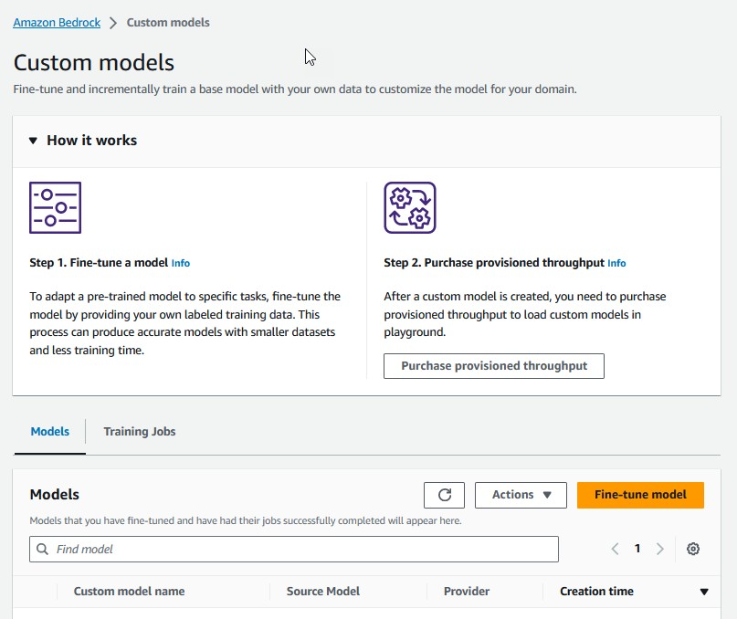

Custom models in Amazon Bedrock
CR E A T E F I N E - TU N E D M O D E L S U S I N G TH E C O N S O L E O R A P I S
Maximize accuracy of FMs by providing a small number of labeled examples
Once deployed, it can be invoked the same way as base models
using playground or through API
Fine-tuning now supported for Amazon Titan and select third-party FMs
(Cohere, Meta)
New!

Slide 21



Customizing model responses for your business
PU R PO S E
DA TA N E E D
PU R PO S E
DA TA N E E D
Maximizing accuracy for specific tasks
Small number
of labeled examples
Maintaining model accuracy for your domain
Large number
of unlabeled datasets

Slide 22














Privately customize models with your data
FI N E - TU N I N G A N D C O N TI N U E D P R E - TR A I N I N G
Deliver tailored, differentiated tail user experiences with customized FMs
Fine-tune Llama 2, Command, and Titan FMs for specific tasks with labeled data
Use continued pre- training to adapt Titan Text FMs to your domain with unlabeled data
None of your inputs to or outputs from Amazon Bedrock will be used to train the original base models
Labeled data
AMAZON S3
FINE-TUNED MODEL
GENERATED CONTENT
Social media
Display ads
Meta—Llama2
AMAZON BEDROCK
Web copy
Meta—Llama2
Copy

Slide 23




Components of a fine-tuning job
Inputs
Outputs
Storage
Inferencing on PT
Base FM
Metrics and logs
Custom models stored securely by Amazon Bedrock
Playground
Hyperparameters
API
Output model
Input data
© 2023, Amazon Web Services, Inc. or its affiliates. All rights reserved.

Slide 24
Model fine-tuning
Place in S3 your dataset for train, and validation jsonl format comprised of instructions
{ ”prompt": ”input text”, ”completion": ”output text” }
Up to 10k training records, and 1k validation records Set hyperparameters
Epoch: 1-10
Batch size: defaults to 1
Learning rate: defaults to 0.00005 Learning warmup steps: recommended 0

Slide 25
Model continued pre-training
Place in S3 your dataset for train, and validation jsonl format comprised of unlabeled data
{ ”input": ”input text”}
Up to 100k training records, and 1k validation records Set hyperparameters
Epoch: 1-10
Batch size: defaults to 1
Learning rate: defaults to 0.00005 Learning warmup steps: recommended 0

Slide 26














Fine-tuning architecture overview
Amazon Bedrock service account
Model deployment account (AWS owned and operated)
Training orchestration
All incoming network traffic via the console, SDKs, and API
Base model
Amazon Bedrock service
Training job
Runtime inference
Provisioned capacity compute
API
endpoint
Fine-tuned model
Identity and access, monitoring and logging
Customer account
Virtual private cloud
AWS
CloudTrail
Amazon CloudWatch
AWS Identity and Access Management (IAM)
Training data Amazon S3
© 2023, Amazon Web Services, Inc. or its affiliates. All rights reserved.

Slide 27
Security and privacy
YO U A R E I N C O NT R O L O F YO U R D A T A
Data is not used to improve models and not shared with model providers
Customer data remains in AWS Region
Support for AWS PrivateLink and VPC configurations
Integration with AWS Identity and Access Management (IAM)
API monitoring in AWS CloudTrail, logging and metrics in Amazon CloudWatch
Custom models encrypted and stored with service or customer managed keys – only you have access to your models

Slide 28



Demo
Fine-tuning with Amazon Bedrock

Slide 29

Conclusion
Common questions
How do I know how much data is needed?
When do I know I’m done?
How do I compare performance of fine-tuned vs. base model?
What is the best format for the fine-tuning datasets?

Slide 30
Introduction to Generative AI on Amazon SageMaker
Ziv Laub
Sr. Solutions Architect
© 2023, Amazon Web Services, Inc. or its affiliates. All rights reserved.
© 2023, Amazon Web Services, Inc. or its affiliates. All rights reserved.

Slide 31








navigating a rapidly evolving ecosystem of models
Common challenges when building with generative AI
protecting your data and meeting regulatory needs
fine tuning models for accuracy and performance
moving from POC to production

Slide 32


Building Gen AI using AWS services
Amazon Bedrock
The easiest way to build and scale generative AI applications with foundation models
SageMaker JumpStart
Access the long-tail of open and closed models; customize and optimize models and deployment
Generative AI
SageMaker Training / EC2
Train foundation models from scratch

Slide 33









SageMaker
END- TO- END ML J OURNEY
Build, train, and deploy ML models for any use case with fully managed infrastructure, tools, and workflows

Slide 34




Machine learning hub
Browse through 400+ built-in algorithms with pretrained foundation models, solutions, and example notebooks
Amazon SageMaker JumpStart
ML hub with foundation models, built-in algorithms, and prebuilt ML solutions that you can deploy with just
a few clicks
Pre-built training and inference scripts
Compatible with SageMaker and configurable with custom dataset
UI as well as API-based
Use the user interface for single click model deployment or API for the Python SDK-based workflow
Notebooks with examples
Jump into notebooks to use selected model with examples to guide you through the entire ML workflow
Share and collaborate within your organization
Share models and notebooks with others within your organization, and allow them to train with their own data or deploy as-is for inferencing

Slide 35



Simplify discovery and deployment
Discover & Select
Customize & Evaluate
Optimize & Scale

Slide 36









Discover foundation models and deploy with SageMaker’s enterprise-ready features
AV AI L AB L E O N S AG E M AK E R J U M P S T AR T
Models | Models | Models | Models | Models | Models | Models | Models
Jurassic-2 Ultra, | Llama 2 7B, 13B, 70B | Command | Falcon-7B, 40B, 180B, | Stable Diffusion XL 1.0 | Lyra-Fr | Dolly | AlexaTM 20B
Mid | Code Llama 7B, 13B, 34B | Cohere Light | Mistral 7B | 2.1 base | 10B, Mini
Contextual answers Summarize Paraphrase
Grammatical error correction
Open LlaMA
RedPajama MPT-7B
BloomZ 176B Flan T-5
DistilGPT2 GPT NeoXT
Bloom
Upscaling Inpainting
Tasks
Text generation Keyword extraction
Information extraction
Question answering Summarization Sentiment analysis Classification
Tasks
Question answering Chat Summarization Paraphrasing Sentiment analysis Text generation
Tasks Machine translation Question answering
Summarization Annotation Data generation
Tasks
Question answering Chat Summarization Paraphrasing Sentiment analysis Text generation
Tasks
Text generation
Information extraction
Question answering Summarization
Tasks
Generate photo- realistic images from text input
Improve quality of generated images
Tasks
Text generation
Long-form generation
Summarization Paraphrasing Chat
Information extraction
Tasks Machine translation Question answering
Summarization

Slide 37
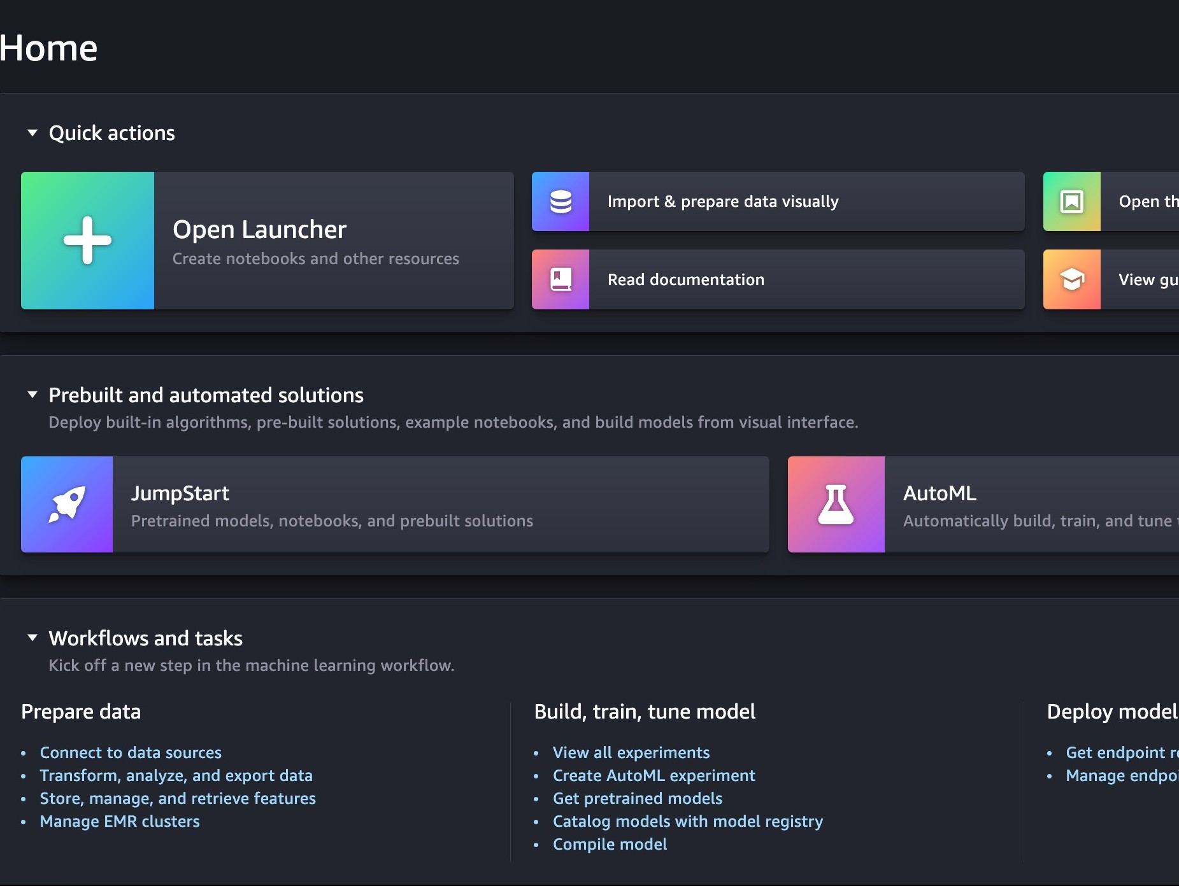
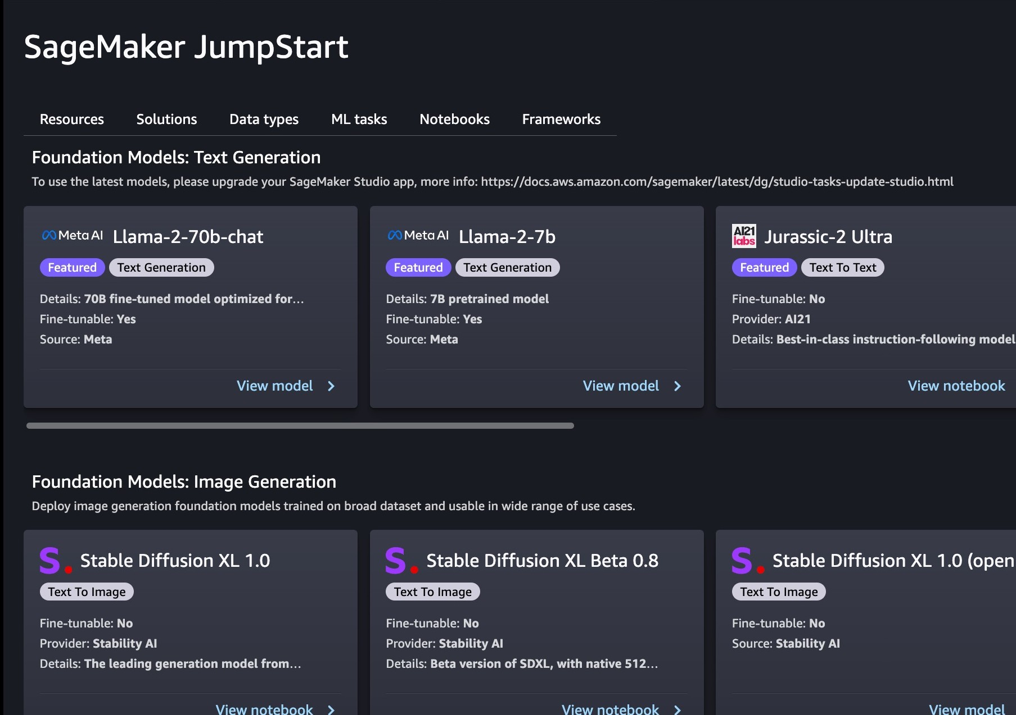
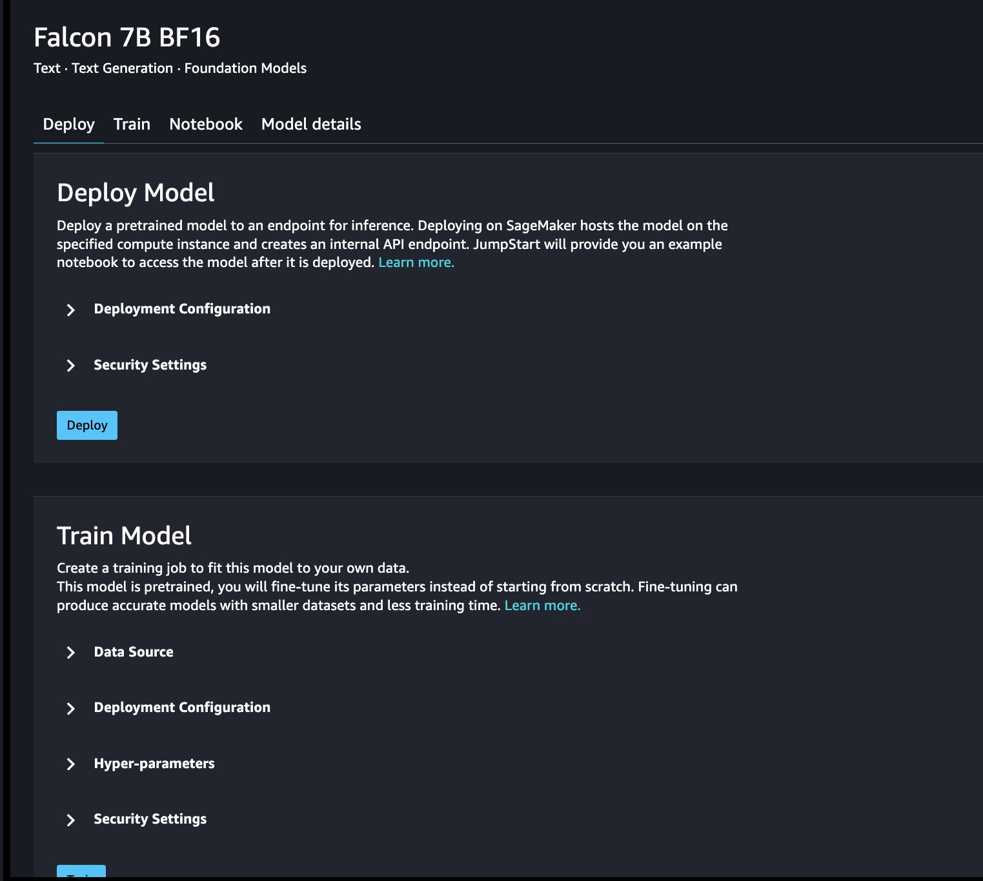
Get started with Gen AI on SageMaker using JumpStart
Discover open and closed models from multiple model providers Easily customize, and deploy to your own SageMaker instances

Slide 38
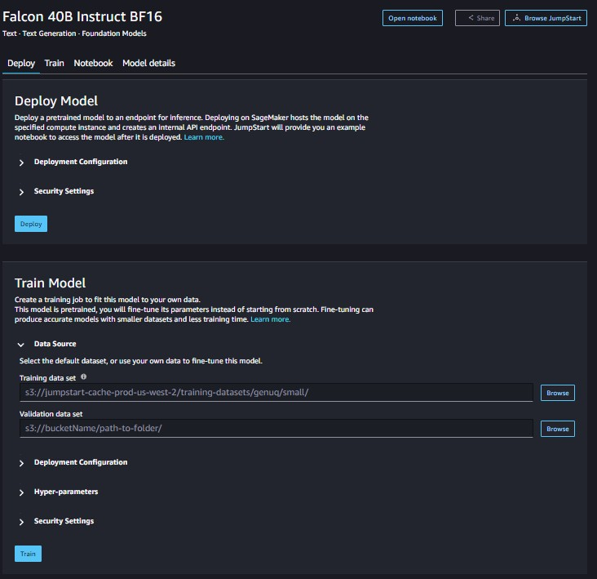
Review model details and take action
Details from model provider:
Model size and description
License info
Use cases and how-to use model
Take action:
Deploy
Train
View API snippet

Slide 39
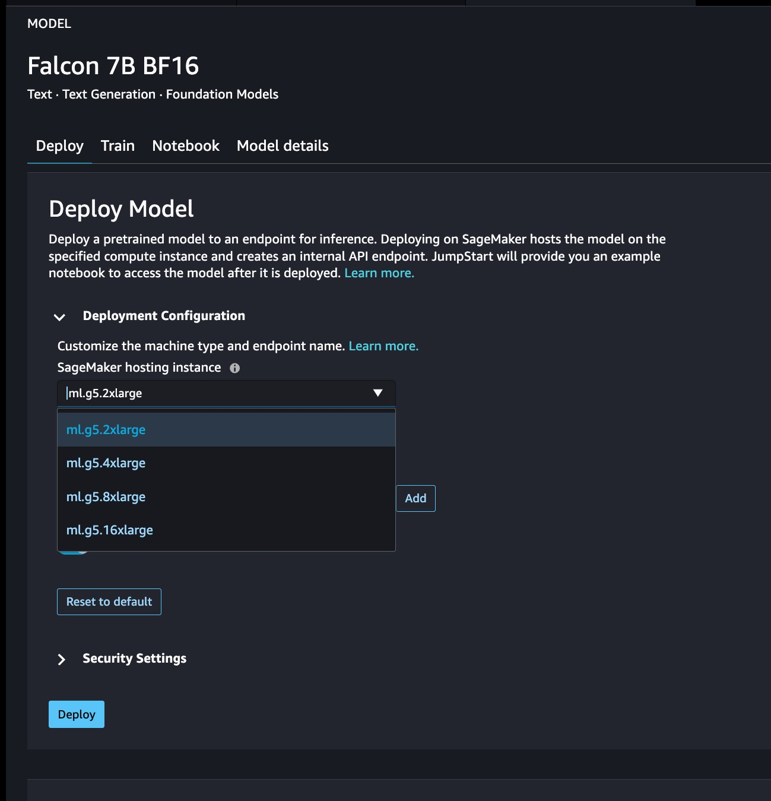
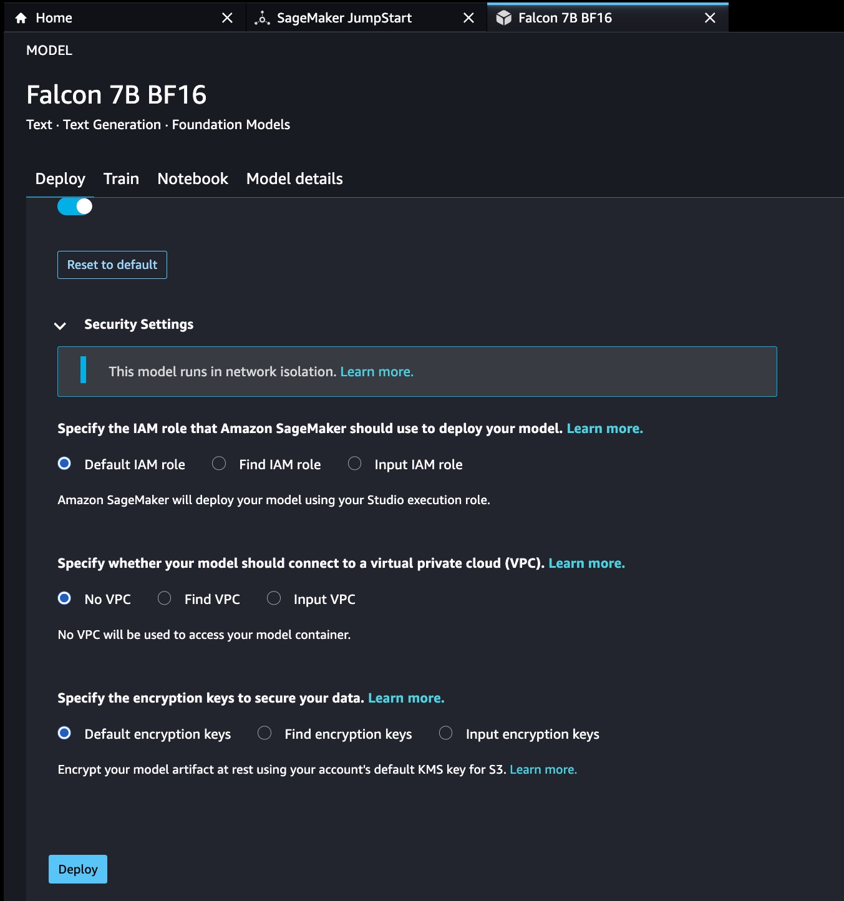
Deploy to SageMaker with just a few clicks
One-click deploy with defaults
Configure for cost, throughput, and latency
Control security and VPC settings

Slide 40
SageMaker JumpStart SDK experience
Deploy pre-trained JumpStart Model
from sagemaker.jumpstart.model import JumpStartModel
pretrained_model = JumpStartModel( model_id="meta-textgeneration-llama-2-7b", model_version= ”2.*”)
predictor = pretrained_model.deploy() prediction = predictor.predict(sample_input)

Slide 41
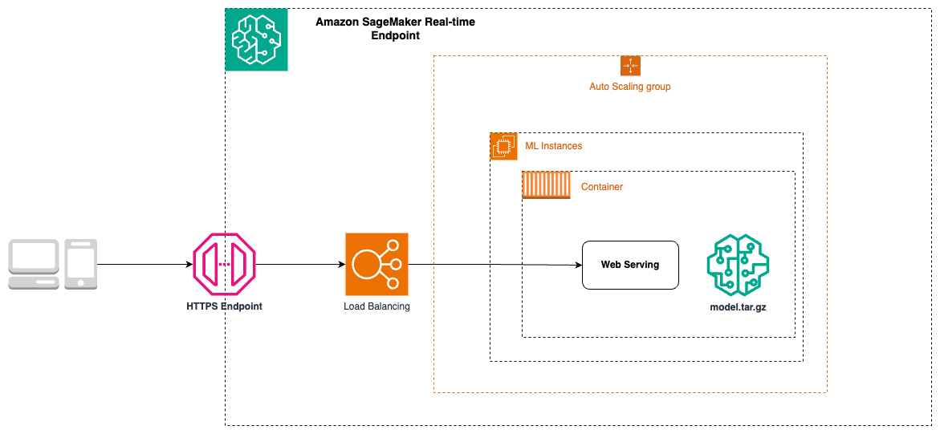
Taking to production: Real-time Inference
Production grade endpoint
SageMaker JumpStart Foundation Model
Real-time response
Accessible from an external application
Autoscaling

Slide 42






Taking to production: Autoscaling
Client Application
Autoscaling
Distributes your instances across Availability Zones
Dynamically adjusts the number of instances
No traffic interruption while instances are being added to or remove.
Scale-in and Scale-out options suitable for different traffic patterns
Support for pre-defined and custom metrics for autoscaling policy
Inference request
Inference Result
Secure Endpoint
{Production Variants}
Automatic Scaling
Availability Zone 1
Availability Zone 2
Availability Zone 3

Slide 43
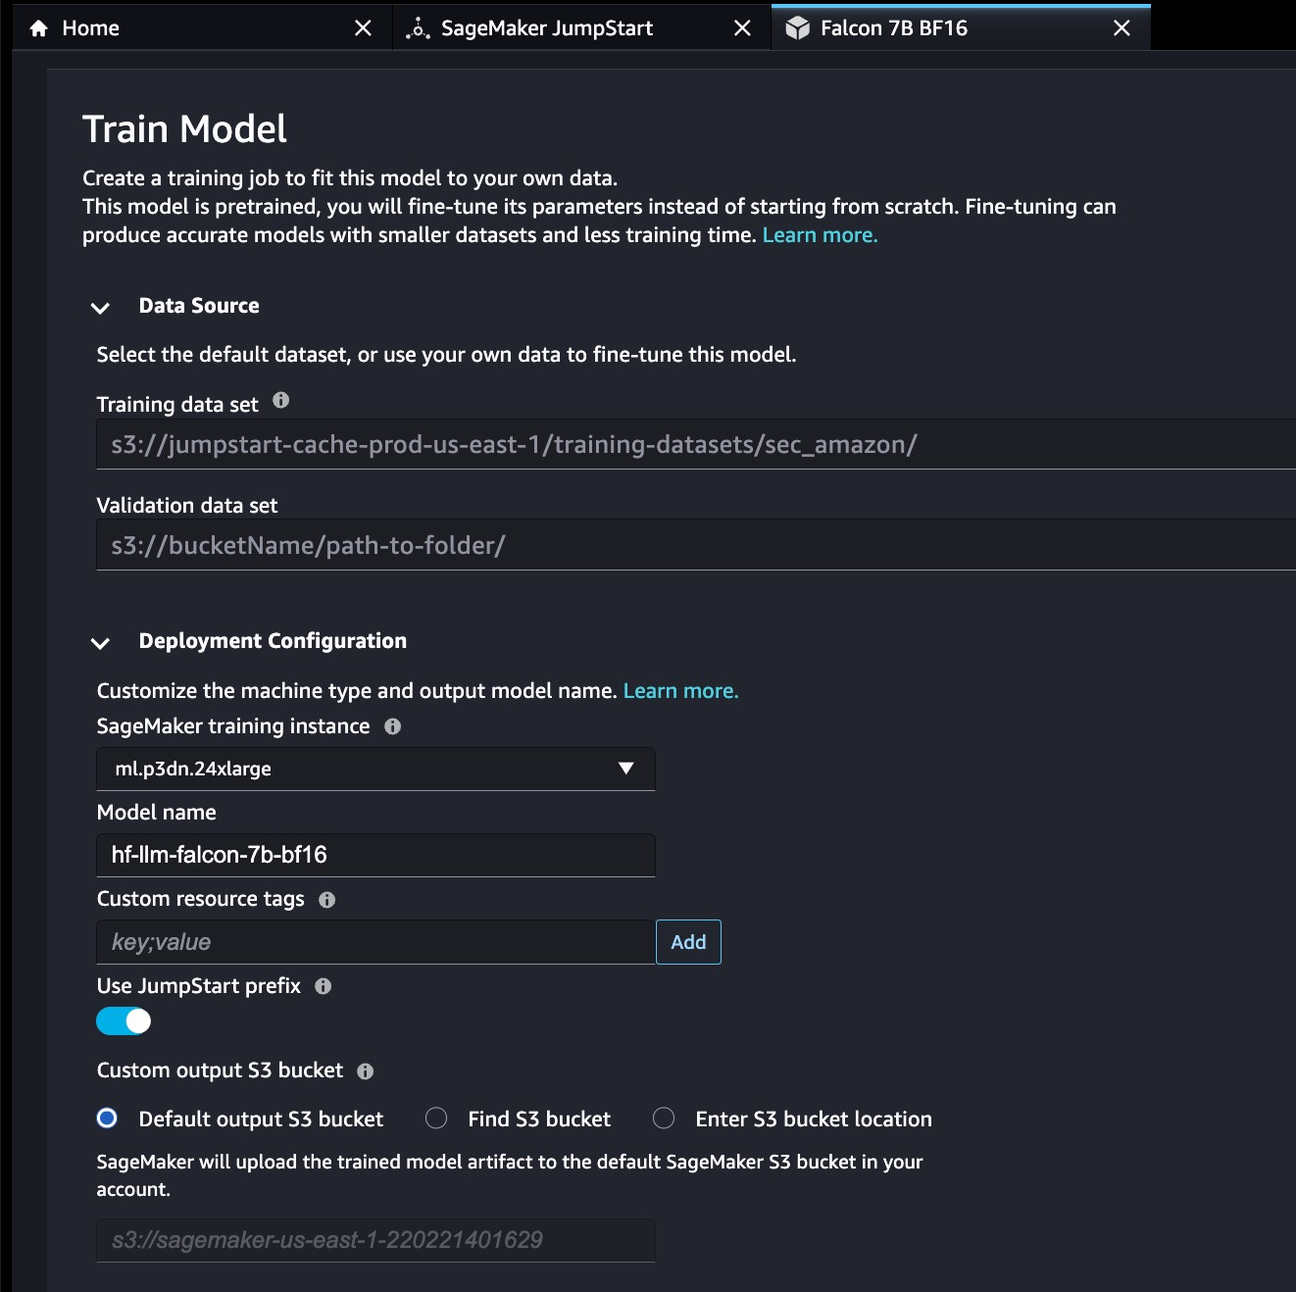
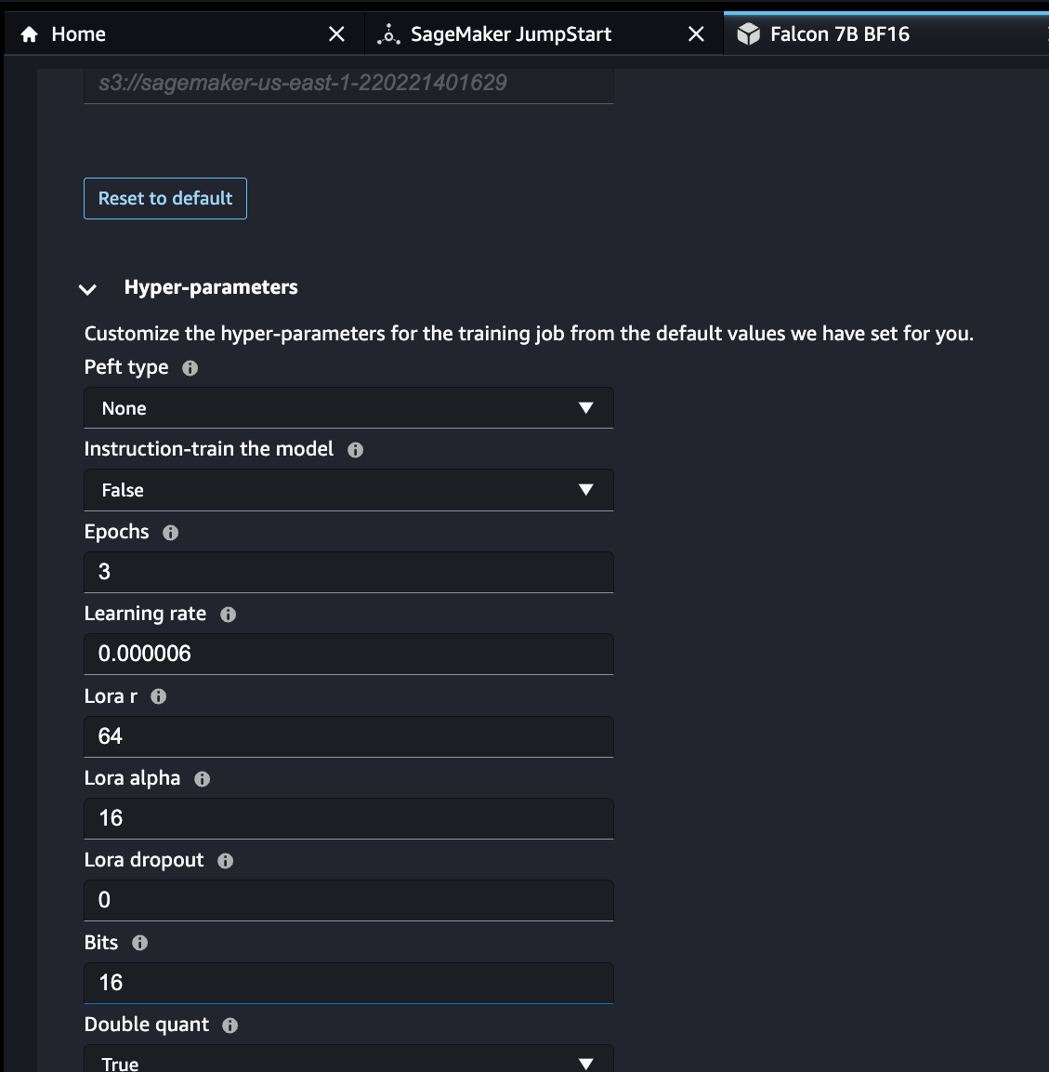
Customize models with your data
Fine-tune open and closed models
Store model weights in your S3 bucket
Control hyper-parameters
Choose preferred instance type

Slide 44
SageMaker JumpStart SDK experience
Fine-tuning
from sagemaker.jumpstart.estimator import JumpStartEstimator
fine_tuning_estimator = JumpStartEstimator( model_id="meta-textgeneration-llama-2-7b", hyperparameters=my_hyperparameters, instance_type="ml.g5.12xlarge",
)
fine_tuning_estimator.fit(
{
"train": training_dataset_s3_path, "validation": validation_dataset_s3_path}, logs=True
)

Slide 45





SageMaker Fine Tuning
2
Provision Training Instance
5
Write trained model to S3
S3 Bucket
SageMaker Managed Training
3
Download Algorithm Image
4
Training Instance
Copy data and model artifacts
Shut down Training Instance
estimator.fit()
6
SageMaker Python SDK
1
Elastic Container Registry

Slide 46


Comprehensive data protection and privacy
Control your inference and training data - not used for service improvement nor shared with model providers
Privately connect between Amazon SageMaker and your virtual private cloud (VPC)
Protect your data with encryption in transit and at rest
Customize FMs privately, retaining control over how your data is used and encrypted
Deploy FMs on single tenant endpoints provisioned for your inference use

Slide 47
Code Llama
Mistral 7B
SD XL 1.0
Model Showcase

Slide 48
Code Llama models
Performant
Capable of generating code, and natural language about code, from both code and natural language prompts. State-of-the-art performance in Python, C++, Java, PHP, C#, TypeScript, and Bash.
Flexible
Offers a higher context window of 16k, compared to the Llama 2 context length of 4k
Open
Open weights and available for research and commercial use¹
Responsible
7B and 13B base and instruct variants support infilling based on surrounding content, making them ideal for code assistant applications
1/ License: https://ai.meta.com/llama/license/
2/ Responsible use policy: https://ai.meta.com/llama/use-policy/

Slide 49
Mistral 7B models
Performant
Supports English text and code generation abilities. Strong throughput and latency performance when compared to larger model alternatives, with low memory requirement at a 7B model size.
Flexible
8k token context length and easily customizable. Mistral 7B- instruct model for chat use cases, fine-tuned using a variety of publicly available conversation datasets.
Open
Open weights and available for research and commercial use¹
1/ License: https://www.apache.org/licenses/LICENSE-2.0

Slide 50




SDXL 1.0 model prompts
Images generated by StabilityAI SDXL 1.0
Highlights: Improved photorealism effect, artistic intelligence, simpler prompting and more accurate.
Prompt guidance: You can change each of the three individually to generate variations of an image:
type of image
description
(realistic/artistic/type of art etc.)
Negative prompts can be used to direct the model to avoid certain objects, colors, styles, attributes ,etc.

Slide 51

Demo
Fine-tune Llama 2 for text generation
on SageMaker JumpStart

Slide 52
Gen AI Evaluation review
FL O O R 2 8 AI M L T E C H T R AC K
February 29th, 2024, Session #4
Gili Nachum
Principal AI/ML Solutions Architect, ISRAEL, AWS
© 2023, Amazon Web Services, Inc. or its affiliates. All rights reserved.
© 2023, Amazon Web Services, Inc. or its affiliates. All rights reserved.

Slide 53
Agenda
Gen AI evaluation – Why and when?
How we evaluate today? When to use what?
Automated evaluation in-depth
FM-Leaderboarder - Summarization Example

Slide 54
Why evaluate?
- MDD - Metric driven development – rely on data to make well formed decisions, and allow experimentation

Slide 55









Evaluation in development life-cycle
Onboarding models
Developers, Infrastructure, Finops, Legal, security departments
Application development
Developers and data scientists
Productionizing Monitoring
Who
Developers, security and Finops team
Developers DevOps
Task
Pick a model to enable in Org Filter by License, compliance Cost/efficiency, Safety
Pick a model for project
Prompt enginerring Preventing regressions
Evaluate fine-tuning
$ cost
Verify guardrails, rebustness and safety
Reduce cost and latency
Measure LLM powered feature success Detect drift (data/model)

Slide 56
Why is evaluating LLMs non-trivial?
It’s still day-1 for LLM powered apps development
Open ended tasks – Creative
Human evaluation or labeling is expensive and slow
Multiple metrics to consider for natural language generation tasks
Someone else’s measurements are not relevant,
Complex interactions - Chat, RAG retriever-LLM, agents)
Non determinism – temperature, prompt sensitivity

Slide 57








How we evaluate today
Onboarding models
Application development
Productionizing
Monitoring
Public benchmarks
Playground, Playground++
Playgrounds or prompt Studios
Manual evaluation of quality
Automated
technical validations
Adversarial testing with crowd source
Cost/efficiency tests
A/B testing,
input/output monitoring

Slide 58
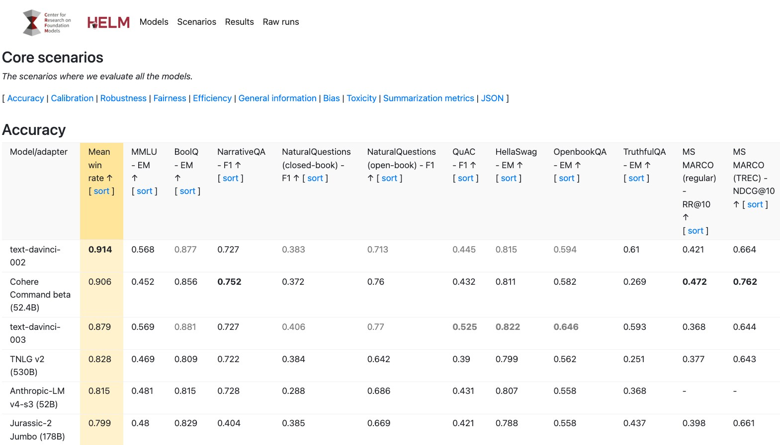
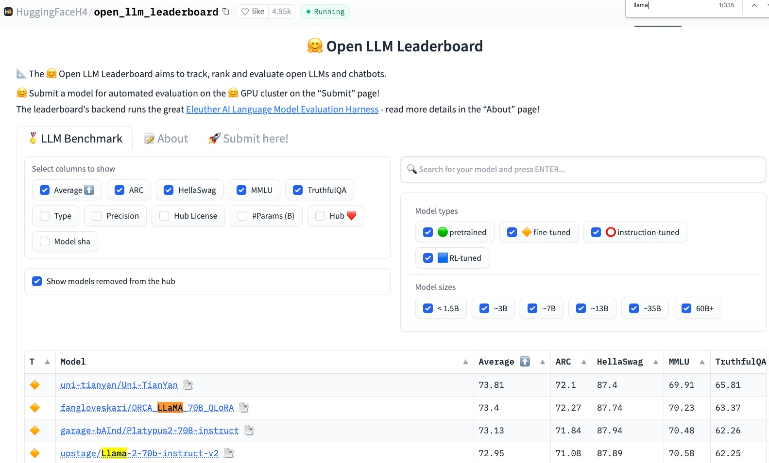
Onboarding model – Public Benchmarks

Slide 59
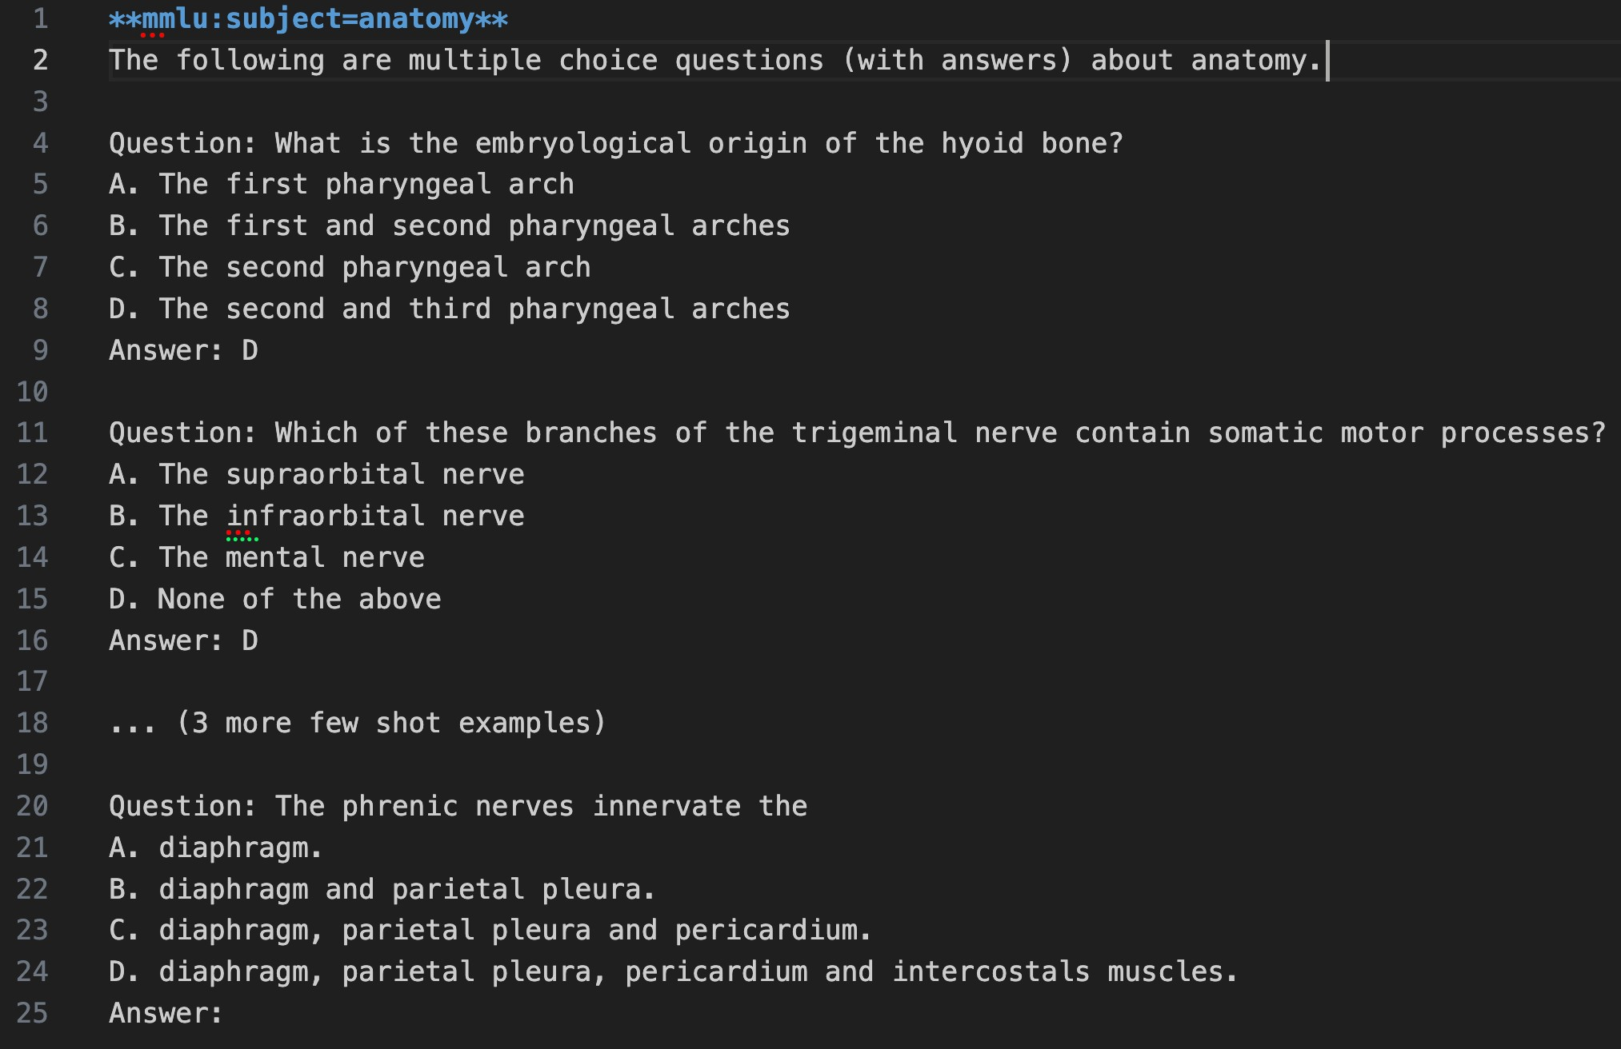
Public benchmarks - some are not what you thought

Slide 60
Working backwords from success – 2
Human metrics > Automated metrics
(For accuracy)

Slide 61
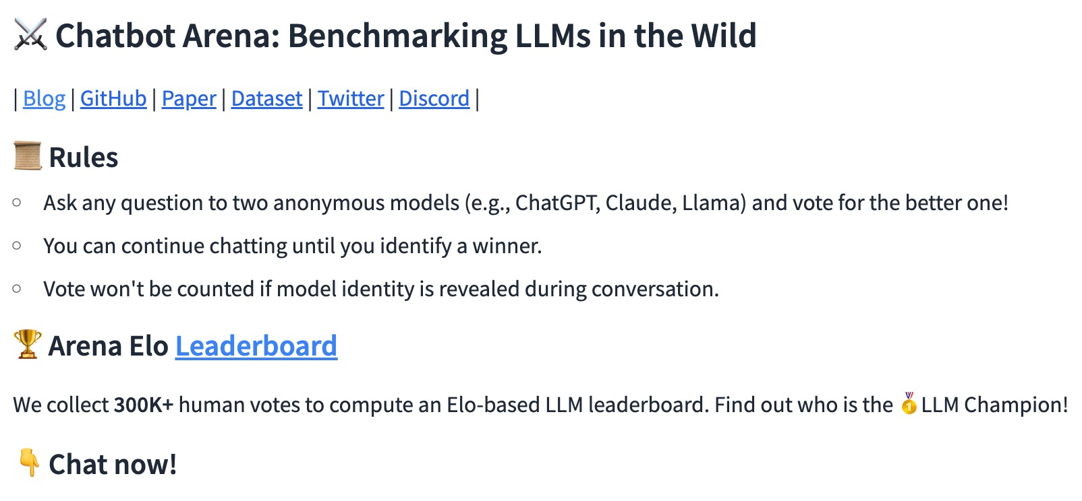
Onboarding model – Chatbot arena

Slide 62
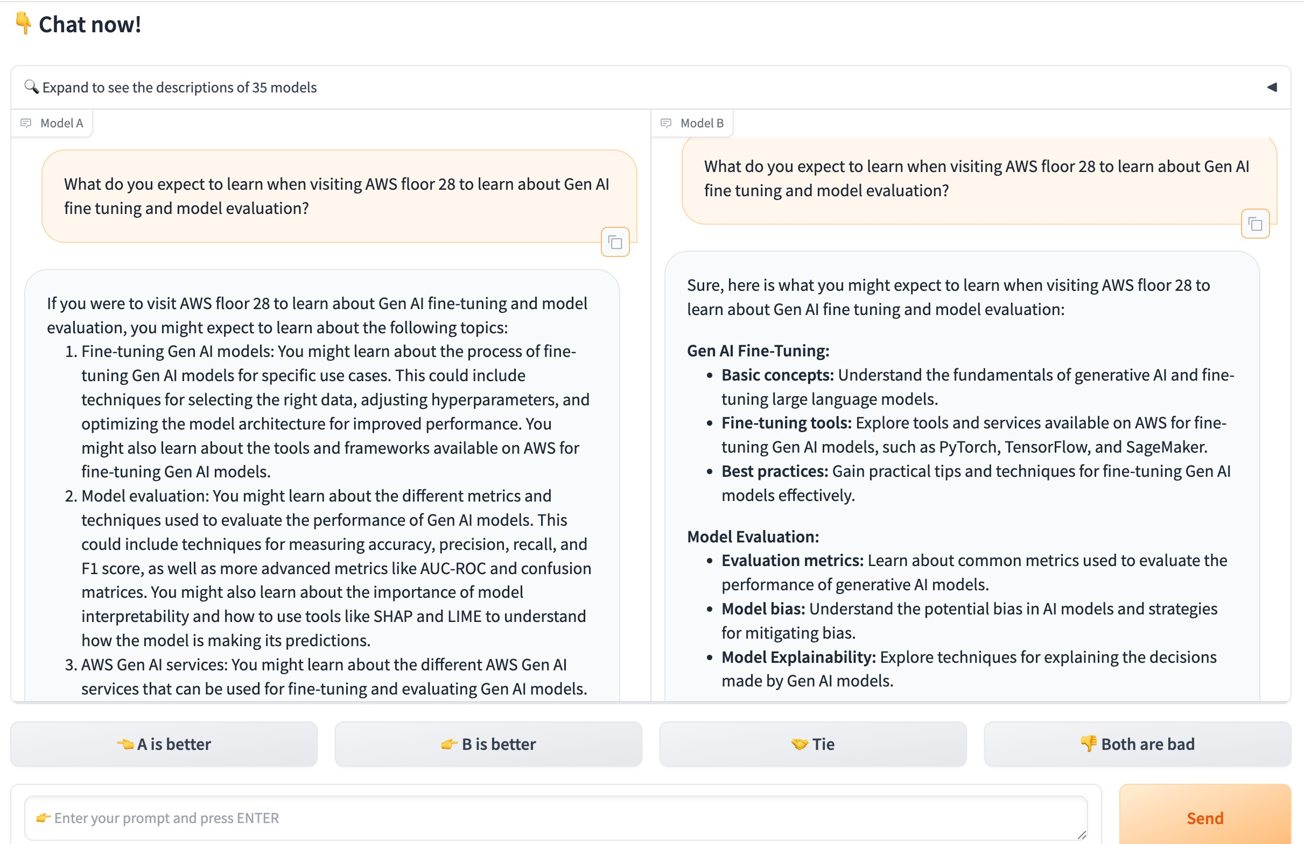
Onboarding model – Chatbot arena

Slide 63
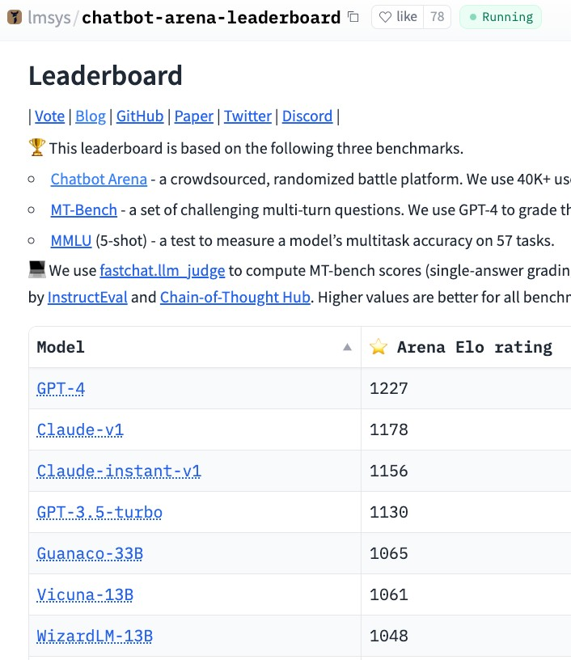
Onboarding model – Chatbot arena

Slide 64
Working backwords from success – 1
Your data > public data
(For accuracy)

Slide 65
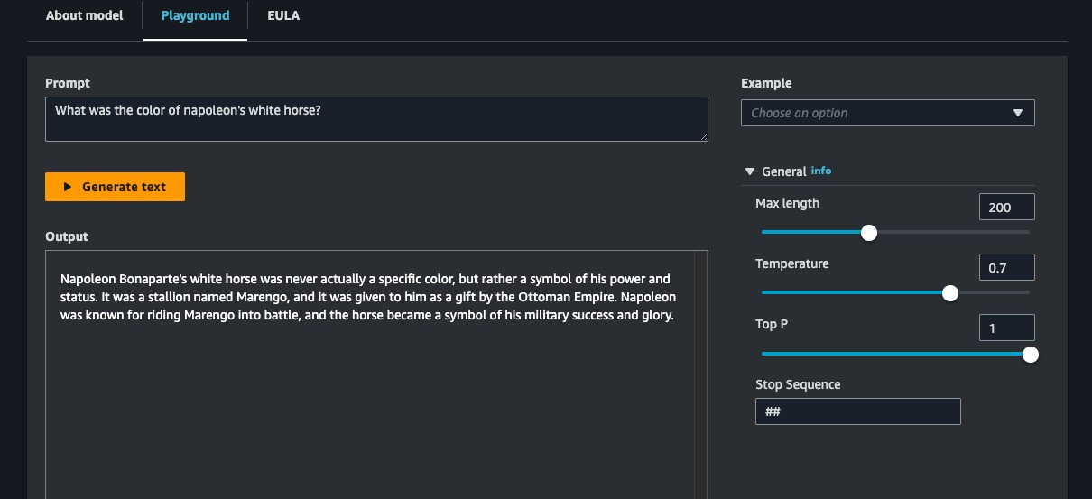
Application Development – Prompt Playground

Slide 66
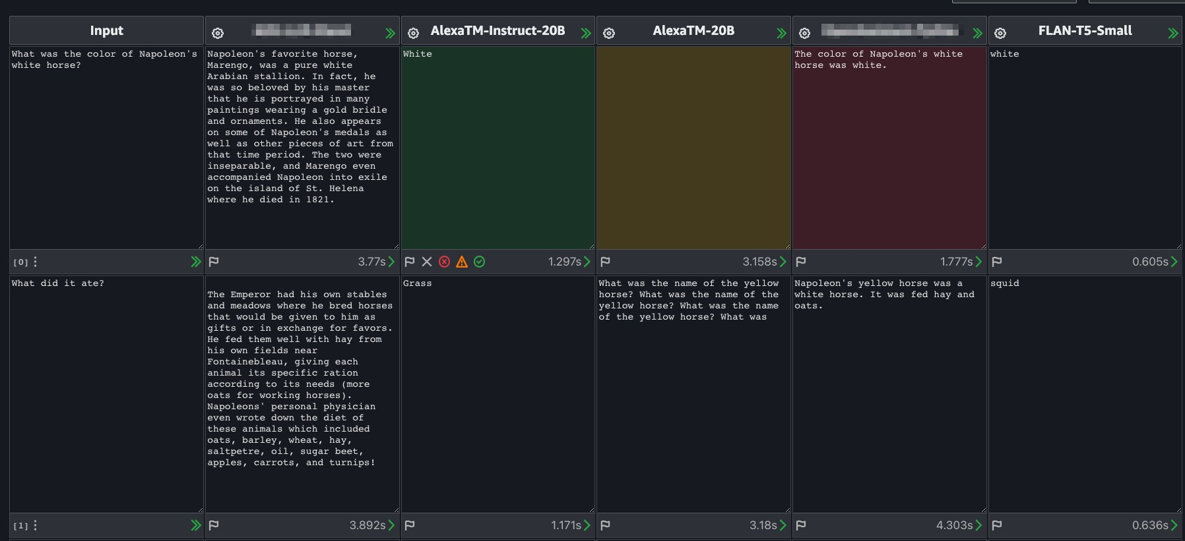
Application Development– Playground++
Chat
© 2023, Amazon Web Services, Inc. or its affiliates. All rights reserved.

Slide 67
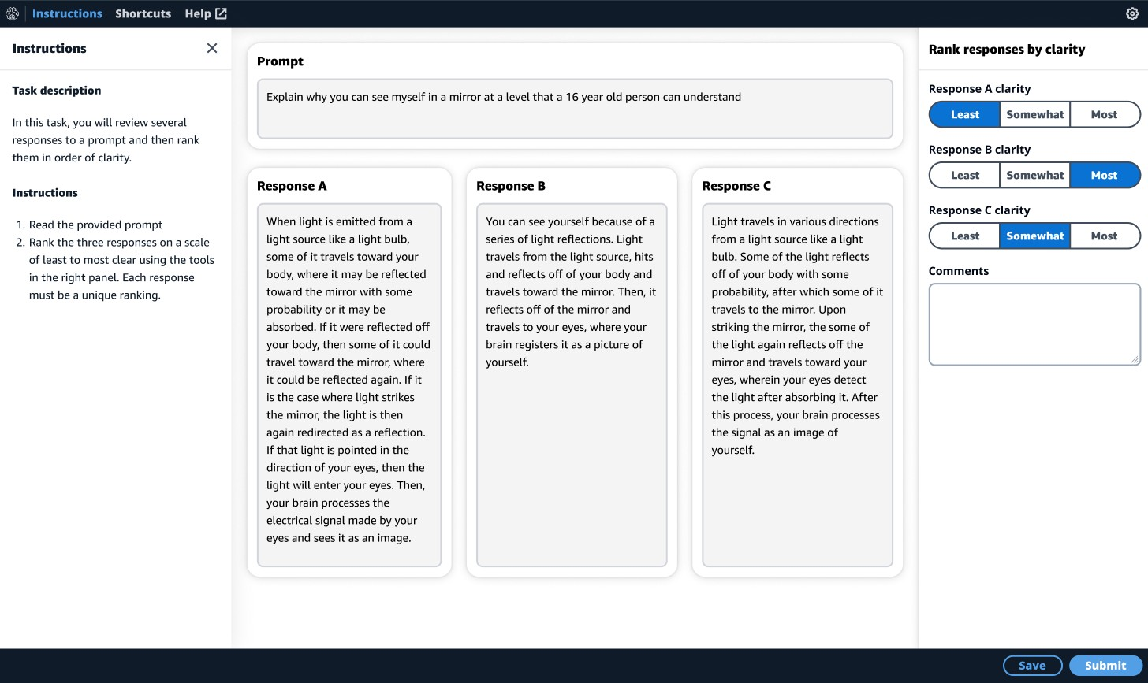
Create preference data w/ SageMaker Ground Truth

Slide 68
Automated Evaluation
Evaluate on your own data – most accurate
Repeatable, cheap
Many metrics – accuracy, toxicity, robustness, custom

Slide 69
Evaluation methods breakdown
 | Human evaluation | Automated Evaluation
Public data | Chatbot arena leaderboard Ask a friend | - Leaderboards: -- HELM -- HF
Your | - LLM Playground | -Automated Evaluation
data | - SageMaker Ground Truth | -- Bedrock
 |  | -- SageMaker Studio
 |  | -- Python based
 |  | --- FMEval
 |  | ---- FM-Leaderboarder
 |  | --- RAGAS

Slide 70



Evaluation methods breakdown
Accurate
 | Human evaluation | Automated Evaluation
Public data | Chatbot arena leaderboard Ask a friend | - Leaderboards: -- HELM -- HF
Your | - LLM Playground | -Automated Evaluation
data | - SageMaker Ground Truth | -- Bedrock
 |  | -- SageMaker Studio
 |  | -- Python based --- FMEval
 |  | ---- FM-Leaderboarder
 |  | --- RAGAS

Slide 71
Evaluation methods breakdown
Easy
 | Human evaluation | Automated Evaluation
Public data | Chatbot arena leaderboard Ask a friend | - Leaderboards: -- HELM -- HF
Your | - LLM Playground | -Automated Evaluation
data | - SageMaker Ground Truth | -- Bedrock
 |  | -- SageMaker Studio
 |  | -- Python based --- FMEval
 |  | ---- FM-Leaderboarder
 |  | --- RAGAS

Slide 72


Monitoring in production
A/B testing by Business KPI
Input/output persistance and monitoring (embeddings based)
User feedback (e.g., )
Track business metric

Slide 73









LLM Evaluation Process – inputs/outputs
Persona responsible
Dataset (optionally w/ ground truth data)
Metrics results JSON / Table / Visuals
Model
Prompt templates
Task
Additional artifacts Request/responses Correct/Wrong responses in/out Tokens
$ cost
Metrics (built-in, custom)
Evaluation Process

Slide 74
LLM Evaluation Process – inputs/outputs
Persona responsible
Dataset (optionally w/ ground truth data)
Metrics results JSON / Table / Visuals
Model
Prompt templates
Task
Additional artifacts Request/responses Correct/Wrong responses in/out Tokens
$ cost
Metrics (built-in, custom)
Evaluation Process

Slide 75
Tasks to evaluate
Classification – binary, multi-class, multi label
Generation: Marketing text, code, SQL, Json, different formats
Summarization: abstractive/extractive, per topic, domain, paper/transcription
Q&A: Open book, Closed-book (RAG)
Chat (multi-turn conversation)
ReAct based Agents
Custom tasks

Slide 76
LLM Evaluation Process – inputs/outputs
Persona responsible
Dataset (optionally w/ ground truth data)
Metrics results JSON / Table / Visuals
Model
Prompt templates
Task
Additional artifacts Request/responses Correct/Wrong responses in/out Tokens
$ cost
Metrics (built-in, custom)
Evaluation Process

Slide 77
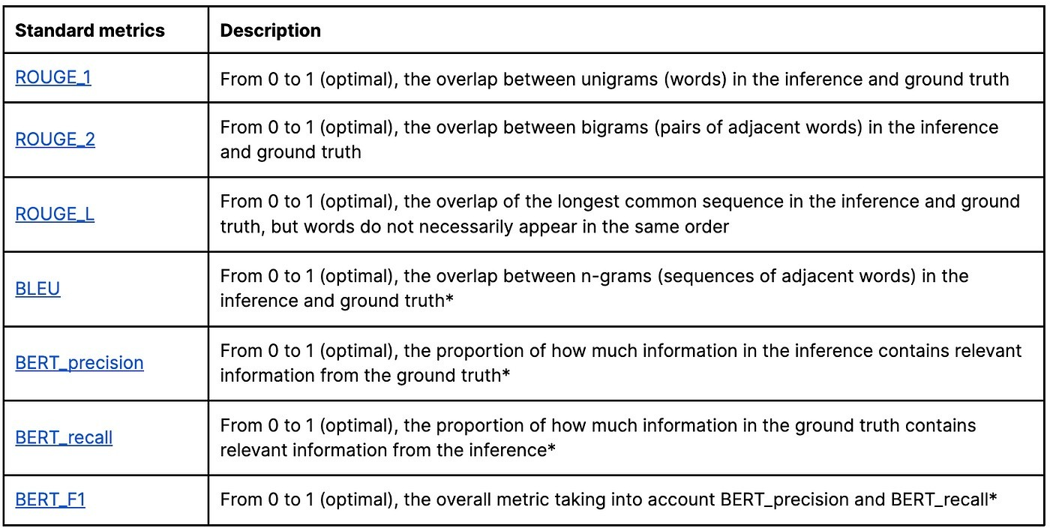
Common metrics for NLG Tasks
NGRAM-based metrics
EMBEDDING-based metrics
© 2023, Amazon Web Services, Inc. or its affiliates. All rights reserved.

Slide 78
Can LLMs evaluate LLMs?
Use a Judge LLM to evaluate the NLG output of an LLM Pros: Cons:
Fast and cheap
Ground truth not required
Explainable (somewhat)
Flexible to support new tasks
Good correlation with human eval for some tasks
Improves with better models
Not at domain expert human performance
Might be oblivious to the mistakes of other LLM
potentially preferring LLM generated text over human
Perf is sensitive to prompt
+ Reference: G-EVAL: NLG Evaluation using GPT-4 with Better Human Alignment

Slide 79
Can LLMs evaluate LLMs?
If the Judge LLM is smarter why not use it as the NLG LLM?
It depends:
Yes – use best model available to you.
No - You prefer to use a cheaper model in production (Cost, Latency), or it’s N/A for you (privacy or compliance limitations)

Slide 80
Conclusion and next steps
Evaluating on your private data is best
Evaluating is weaved into your app dev life cycle
Automated tests pays off
Try Evaluation! UI: Bedrock/SageMaker studio | Python FMEval/FM-Leaderboarder
It’s still Day-1 - keep learning and playing

Slide 81



More resources
1
FM-Leaderboarder (Available start of March) https://bit.ly/3Iic9M
2
What’s the Best LLM for Hebrew Classification? – Blog and code example for benchmarking a classification use case
3
Twitch on HELM for your own use case

Slide 82




Thank you!
Please complete the session survey in the mobile app
Gili Nachum
Principal AI/ML Solutions Architect, ISRAEL, AWS
www.linkedin.com/in/gilinachum/
© 2023, Amazon Web Services, Inc. or its affiliates. All rights reserved.

